Slide 1
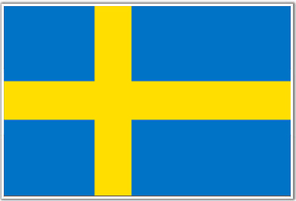
Sweden
By: Mariah and Celeste

Slide 2
Fun Facts
A popular souvenir is the road sign for moose-crossing. Every year a huge number of these signs are stolen from Swedish roads.
The first ice hotel of the world was built near the village of Jukkasjärvi, in Kiruna district of Sweden.

Slide 3
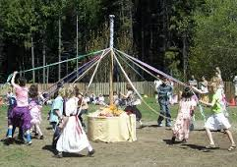
Craft Project
A maypoles is all over Sweden

Slide 4
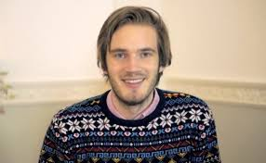
Famous People
PewDiePie is one of the people that are famous in Sweden.
Age:25 years old
Before Fame: He dropped out of the Chalmers University of Technology to pursue a career as an internet personality.
About him: Born Felix Kjellberg, he is a YouTube celebrity whose video game commentary channel has earned over 30 million subscribers. His internet show, Let's Play, focuses on horror and action video games. He was voted Most Popular Gaming Web Star at the 2014 Teen Choice Awards.

Slide 5
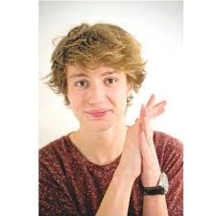
Famous People
Another is Oscar Enesetad.
Age:17 years old
About him: Oldest member of the Swedish pop boyband The Fooo Conspiracy who won the Swedish Grammis award for Innovator of the Year.
Before Fame: Growing up he wanted to be an astronaut or a "singsonger" as he used to call it at a young age.

Slide 6
History
During the 11th and 12th centuries, Sweden gradually became a unified Christian kingdom that later included Finland. During the early Middle Ages, the Swedish state also expanded to control Nor land and Finland. Modern Sweden started out of the Kalmar Union formed in 1397 and by the unification of the country by King Gustav Vasa in the 16th century

Slide 7
Population
The population of Sweden is 9.7 million right now.
15% of the people in Sweden were born in a different country

Slide 8
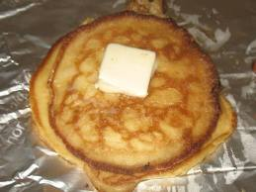
Food
Supplies for Traditional Sweden Pancakes
7 1/2 eggs
6 1/4 cupslow-fat milk
3 1/8 cupsflour
1 1/4 teaspoonssalt
7 1/2 tablespoonsbutter or 7 1/2 tablespoonsmargarine, melted

Slide 9
Food
Instructions for Traditional Sweden Pancakes
1.In a large mixing bowl, beat the eggs with half the milk.
2.Beat in flour and salt until smooth.
3.Stir in melted butter and remaining milk.
4.Heat a griddle or large skillet with a small amount of vegetable oil.
5.For each pancake, pour about 1/4 cup batter onto the griddle and cook over medium heat 1 to 2 minutes.
6 .With a spatula, turn the pancakes and cook until golden brown, about ½ minute.
7.Serve immediately or keep warm while making the remaining pancakes

Slide 10
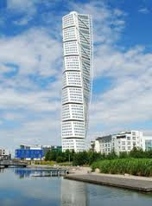
Famous Buildings
The Turning Torso is 646 ft.
It was made in Malmo
It was completed in 2005
It is the tallest building in Scandinavia

Slide 11
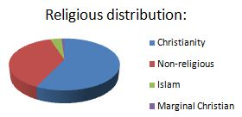
Religion
Lutheran Christian church is officially the largest religion in Sweden 66% of the population
Islam is the second largest religion at 5% of the population
The rest are other ones

